Slide 1


Slide 2
MUSIC STORE ANALYSIS PROJECT
PROJECT FOR FINDING SOME USEFUL INSIGHTS FOR BUSINESS GROWTH OF MUSIC STORE USING SQL

Slide 3
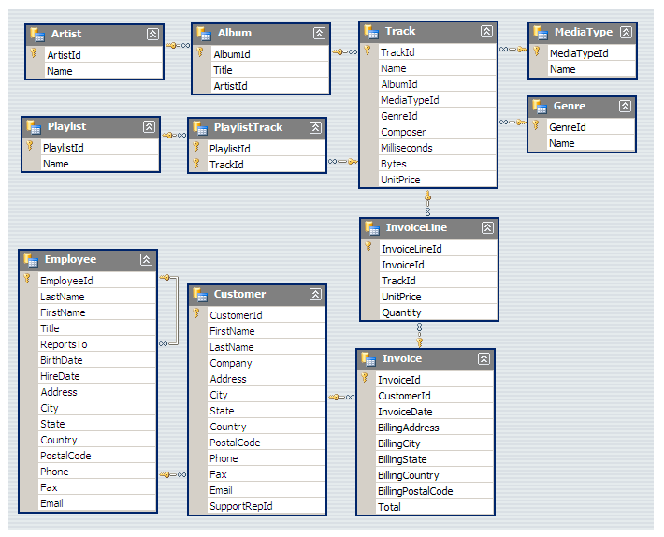
Understanding the dataset: The Music store dataset contains total 11 tables. The schema diagram for this dataset is shown below

Slide 4
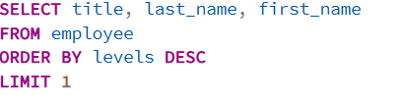

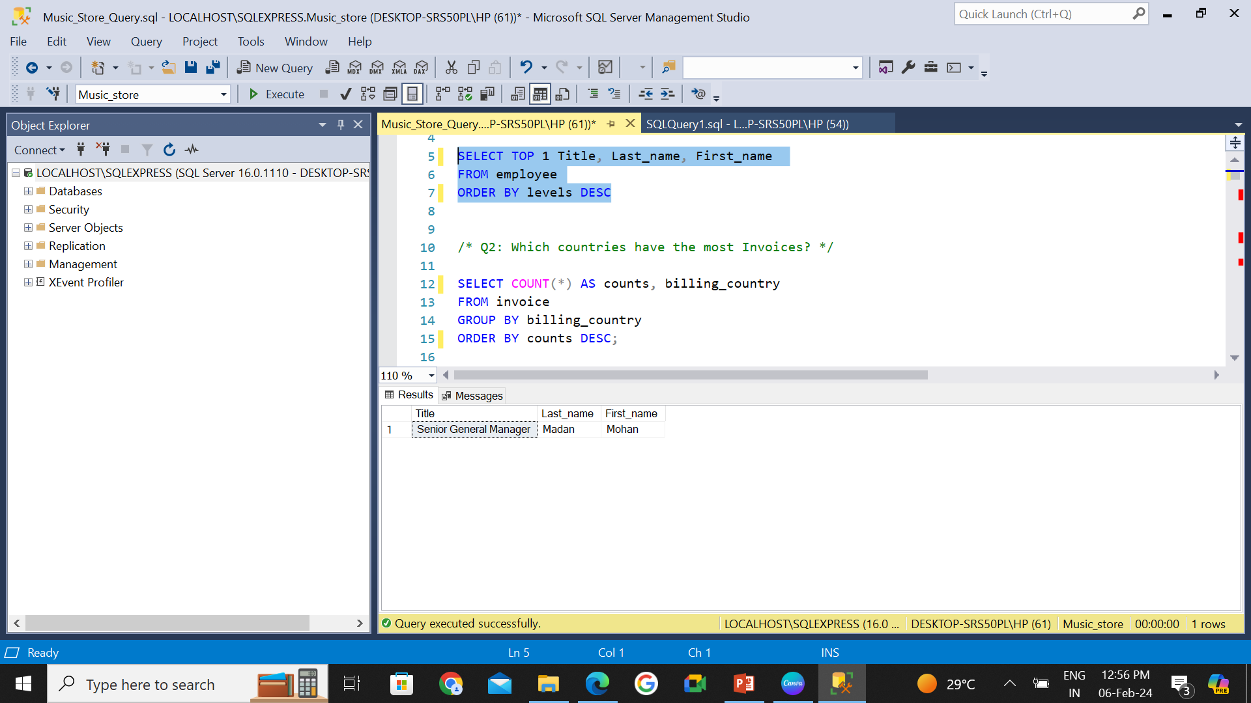
who is senior most employee based on job title?

Slide 5
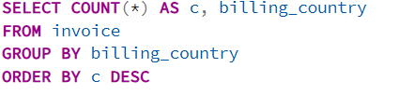
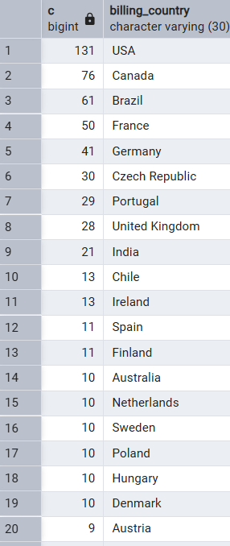
Which country have the most invoices?

Slide 6

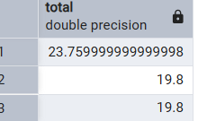
What are the top 3 values of invoices?

Slide 7
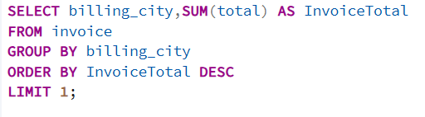

Which city has the best customers? We would like to throw a promotional Music Festival in the city we made the most money. Write a query that returns one city that has the highest sum of invoice totals. Return both the city name & sum of all invoice totals

Slide 8
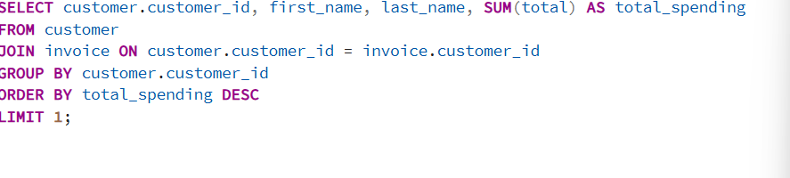

Who is the best customer? The customer who has spent the most money will be declared the best customer. Write a query that returns the person who has spent the most money

Slide 9
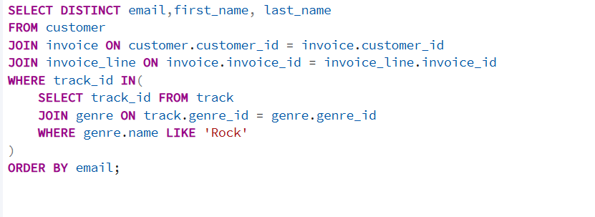
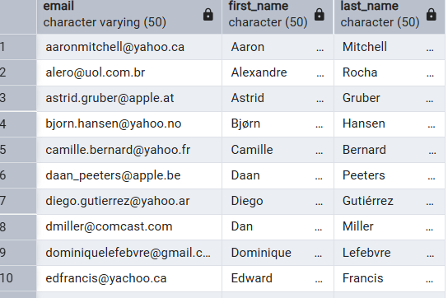
Write query to return the email, first name, last name, & Genre of all Rock Music listeners. Return your list ordered alphabetically by email starting with A

Slide 10
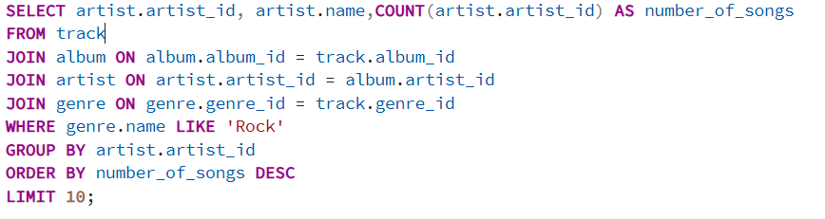
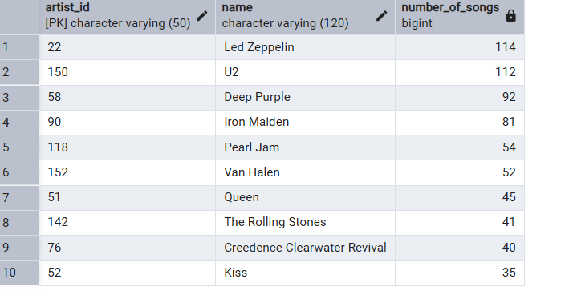
Let's invite the artists who have written the most rock music in our dataset. Write a query that returns the Artist name and total track count of the top 10 rock bands

Slide 11
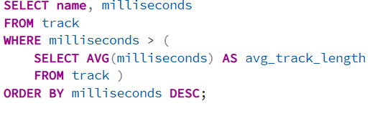
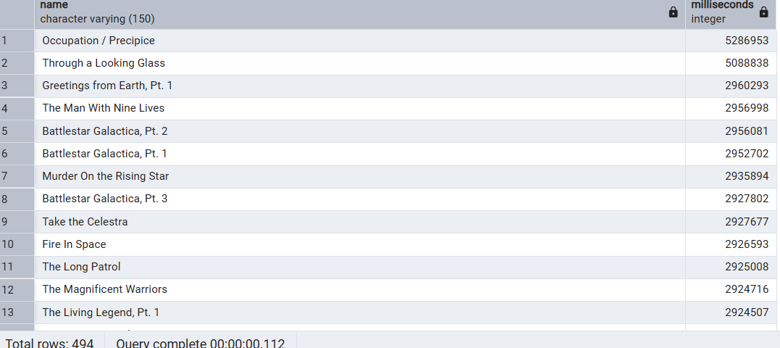
Return all the track names that have a song length longer than the average song length. Return the Name and Milliseconds for each track. Order by the song length with the longest

